Slide 1
Questions with like
Basic 4 – Unit 12 a

Slide 2
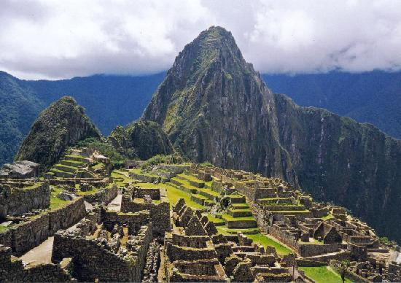
Where is Machu Picchu?
Machu Picchu is in Cuzco
What is Machu Picchu like ? (Description)
It is _____________ (use adjectives to describe)

Slide 3
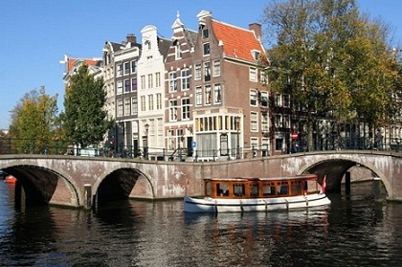
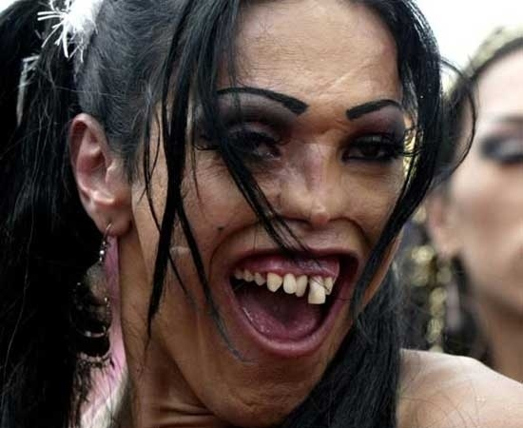
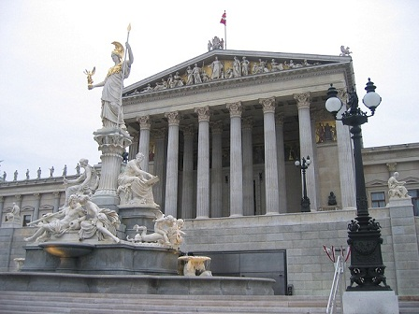
Beautiful
Ugly

Slide 4
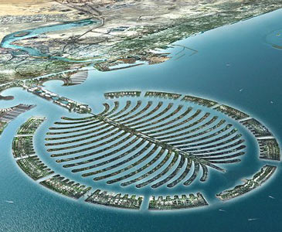
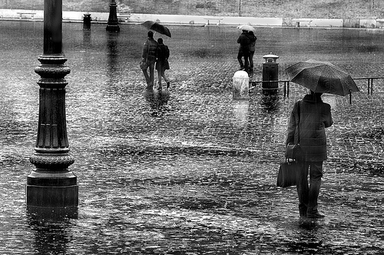
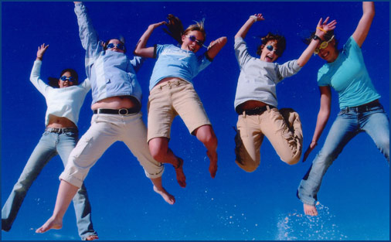
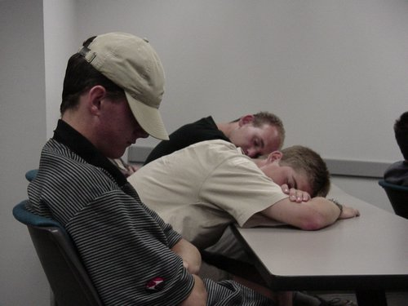
Interesting
Boring
Fun

Slide 5
What are you like?

Slide 6
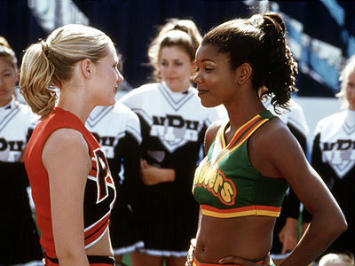

Slide 7
